Slide 1
www.bmfindia.org

Slide 2
About Us
Legal Status
Registered as non-profit company under Indian Companies Act
Non-government aided
Working for the benefit of underprivileged children of the society
Management Team - Directors
Dr. Rajendra Saoji {M.B.B.S, M.S, M.Ch, D.N.B}
Madhur Maheshwary {M.Com, MBA}
Advisors & Friends
CA Gaurav Jaipuria & Co.
Shri Mohan Gandhe (GCC, City Premier College, MKH Sancheti Public School)
and many others

Slide 3
Our Work
Pediatric surgical treatment
Weekly surgical project
Annual surgical mission
Education
Practical computer education at schools with underprivileged children

Slide 4
Sowing of the seeds….
Pilot project with Anandwan & School Health Program
Lead from Anandwan about children of farmer suicide affected families.
50 surgeries performed successfully from November 2011 to March 2012

Slide 5
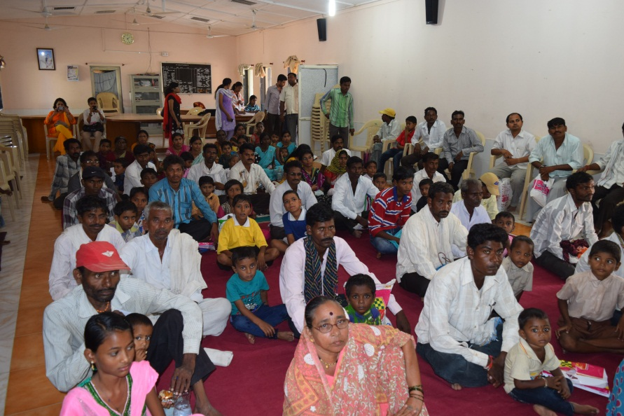
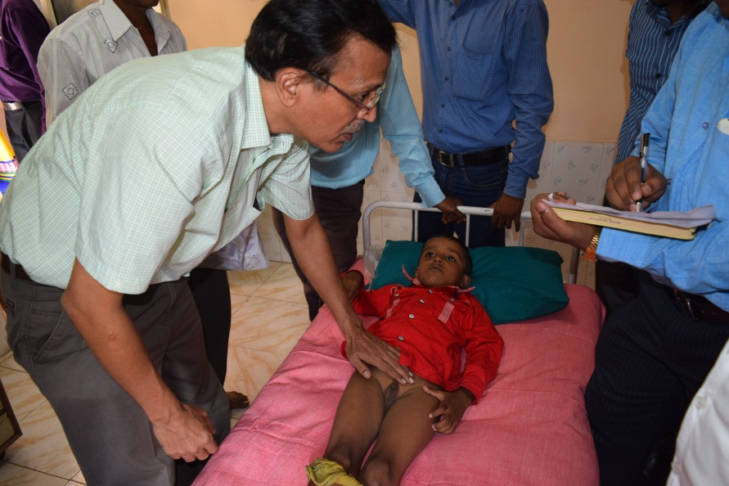
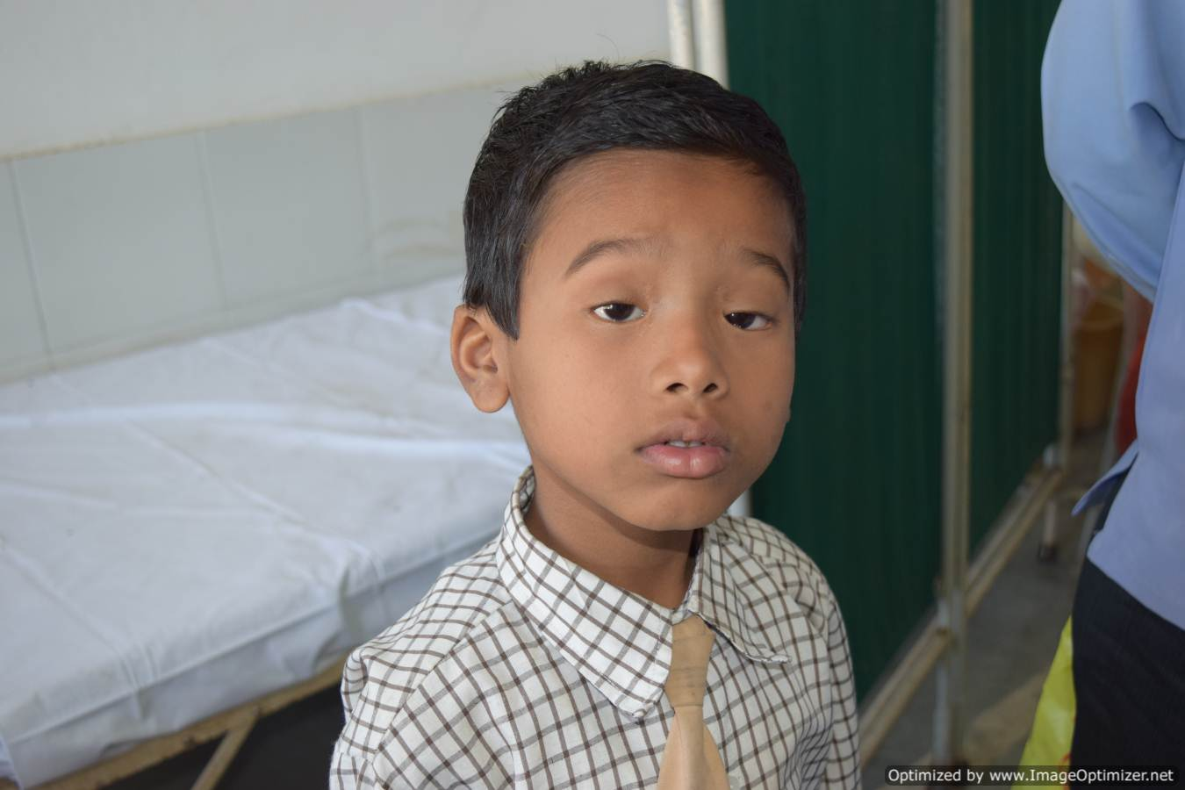
Screening Camps to shortlist surgical patients in rural areas …

Slide 6
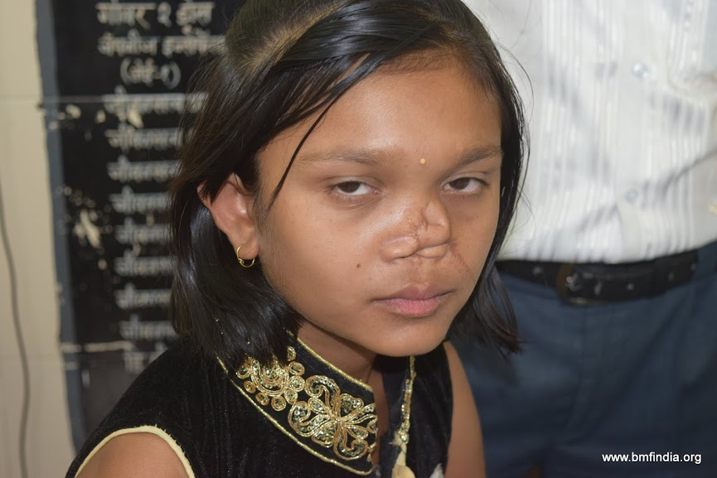
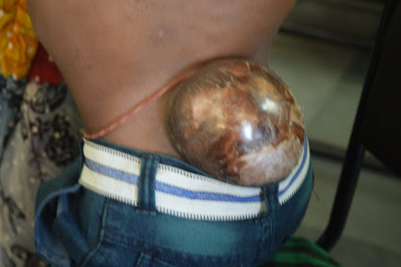
A look at the Screening Camps…

Slide 7
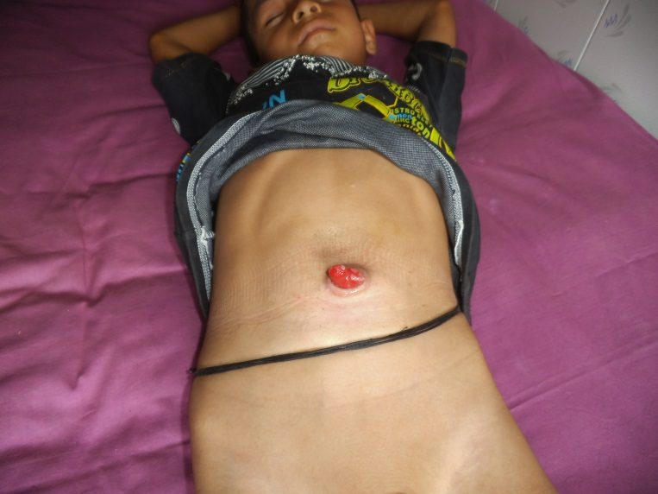
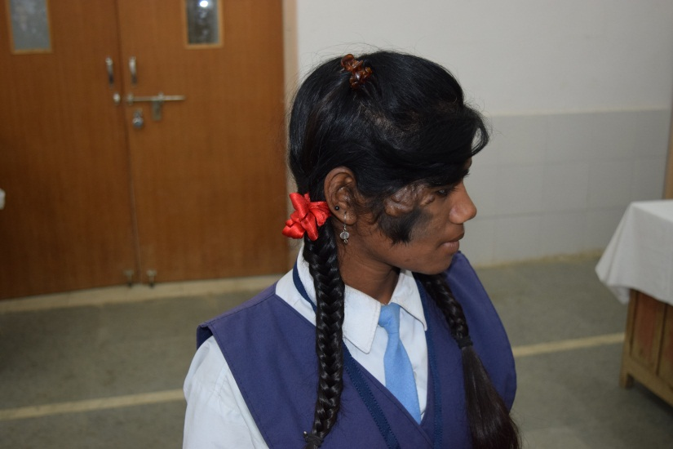
A look at the Screening Camps…

Slide 8
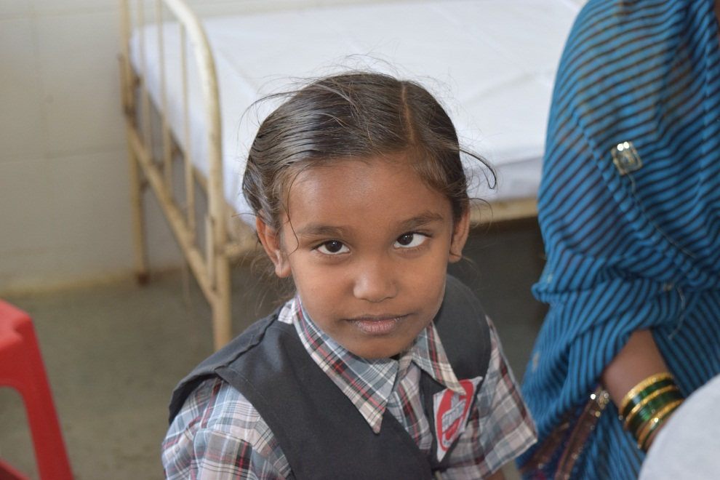
A look at the Screening Camps…
Every screening camp yields dozens of patients covering diverse specialities such as Orthopedic – Spine, Urology, Ophthalmic, Plastic, etc., which are all treatable under the ambit of BSM.

Slide 9
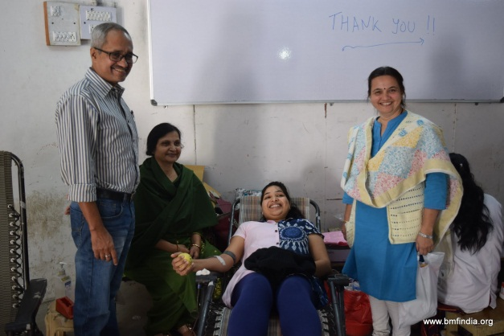
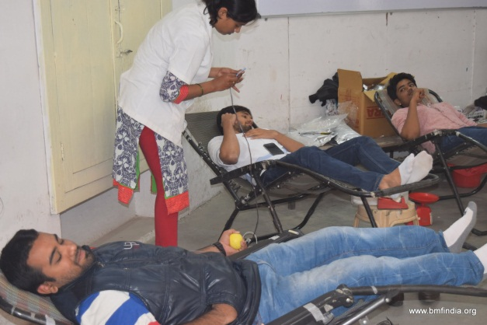
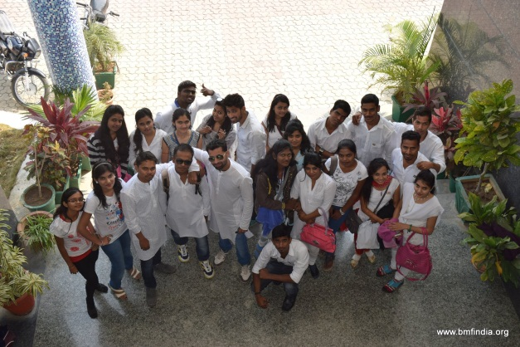
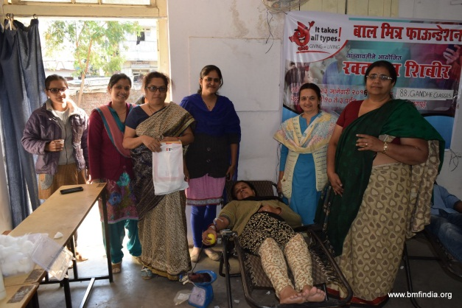
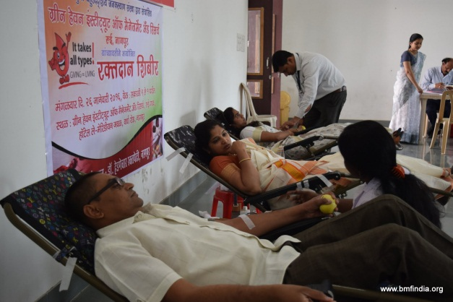
A look at the blood donation camps
Over 100 units of blood donated by students at Gandhe Commerce Classes &
Green Heaven Institute of Management. Our sincere thanks to Mr. Mohan Gandhe and
Mr. Anil Sharma for making necessary arrangements!

Slide 10
Pediatric Surgical Treatment Workflow
Balmitra + Taluka Team organize screening camp at Taluka level
Final surgical cases shortlisted
Shortlisted cases called for surgery 2-3 cases/week
Complete batch of shortlisted patients treated. Prepwork for next screening camp begins

Slide 11
Balmitra Approach-Pediatric Surgical Treatment
Weekly Surgical Project
2-3 surgeries per week round the year for patients from Nagpur & Chandrapur district and other states as well.
Word of mouth ensures patients coming in from different states too!
>> 520 surgeries done since Nov 2011
Annual Surgical Missions
Medical team from US and other countries join us in Nagpur in this unique surgical treatment mission.
Status: more than 300 surgeries done since 2014.

Slide 12
Wide scope of Pediatric Cases
Urology
Ophthalmology
Orthopedics
Head/Neck/Face
Neurology
Plastic surgery
And more…(except cardiac cases)

Slide 13
High Quality healthcare at your service!
Well qualified professional Pediatric surgeons
Good Infrastructure Hospital partner
Equipment (pediatric ventilators, etc.)
Anaesthesia department/staff
Adequate nursing staff
Pediatric intensivist
Quality medicines and consumables
Medicines partner – Bombay Medical Stores
Specific implants sourced from USA

Slide 14
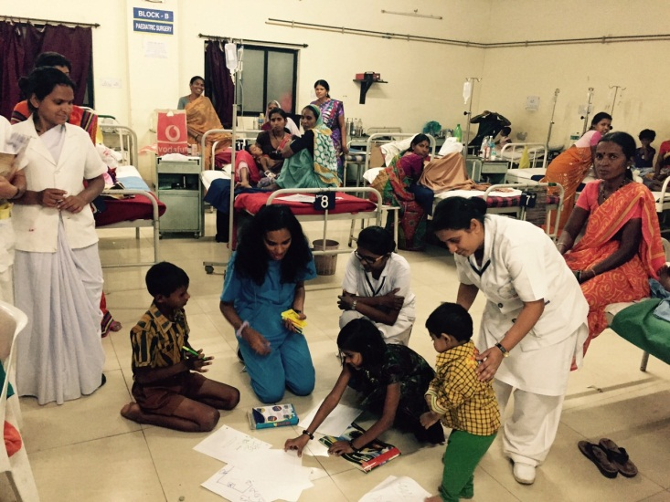
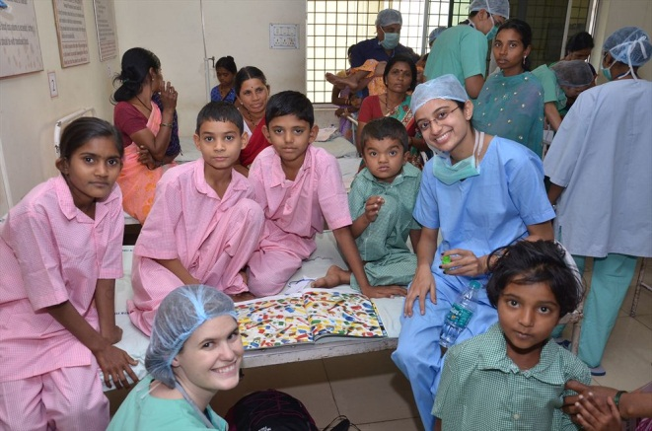
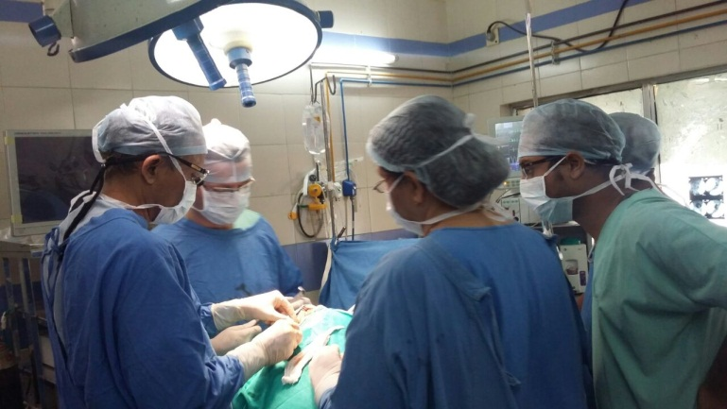
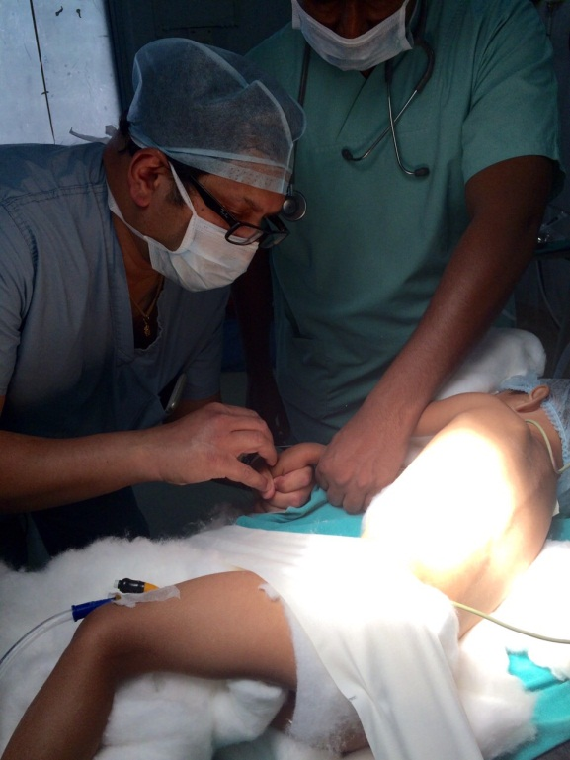
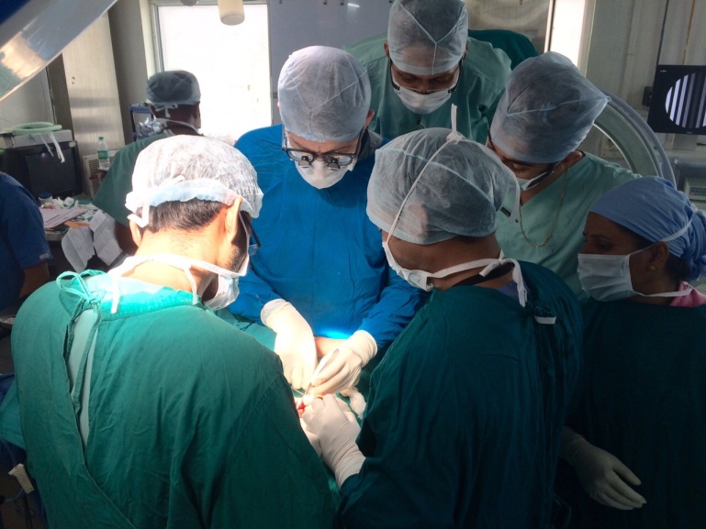
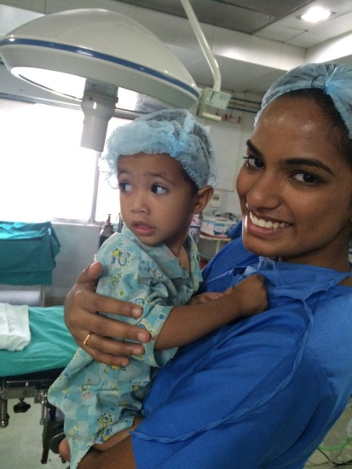
A typical day during surgical mission

Slide 15
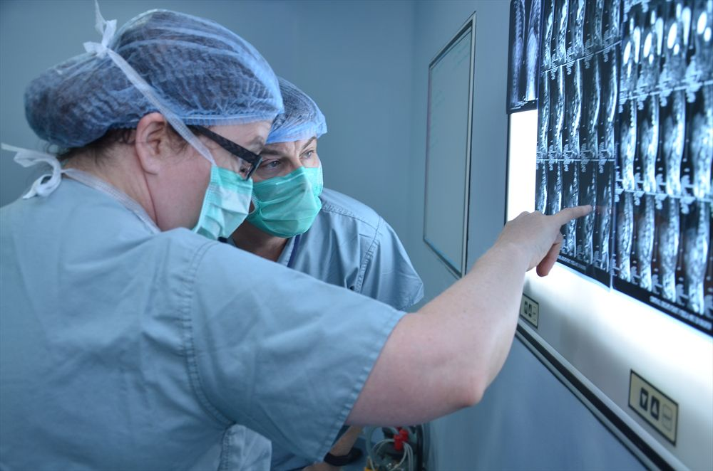
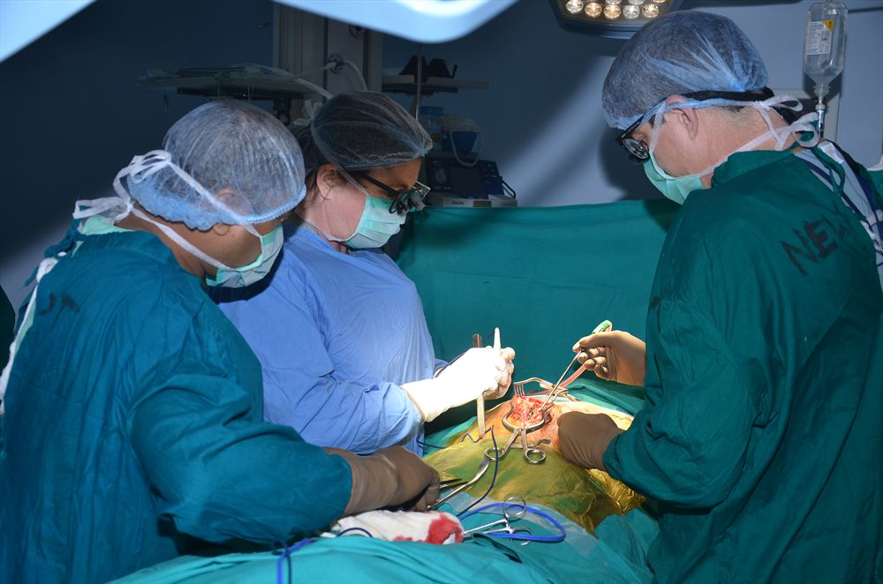
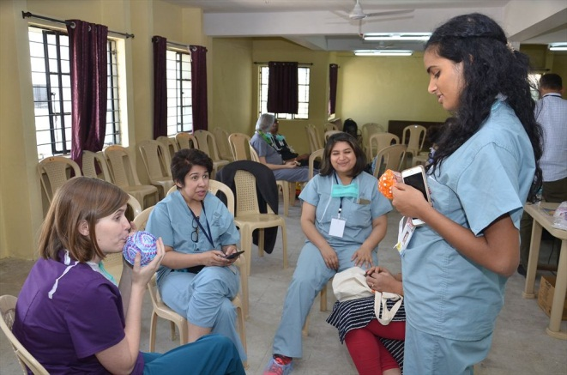
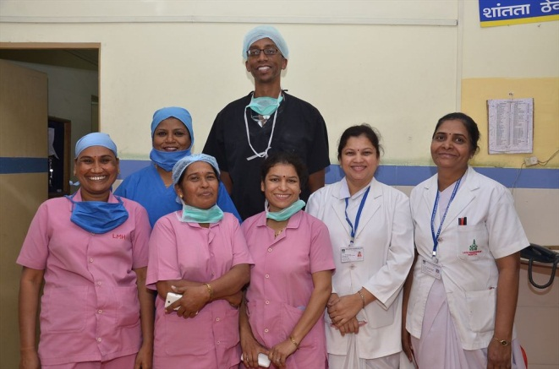
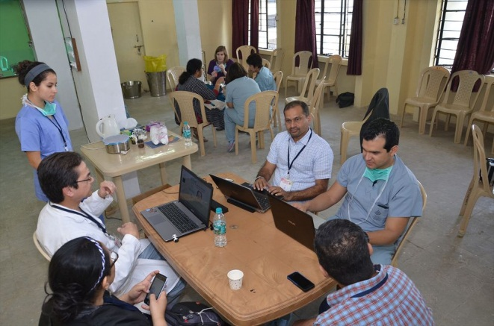
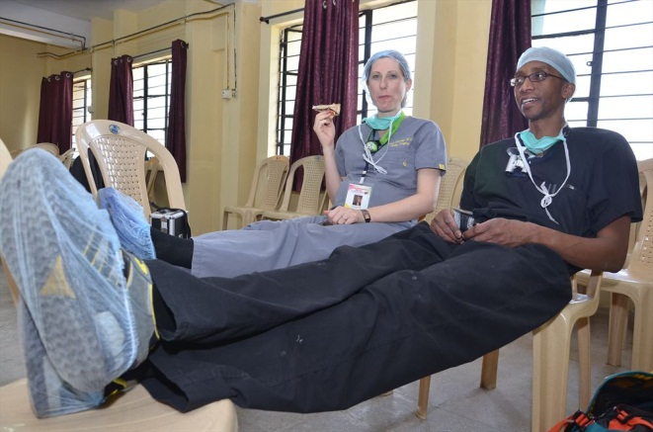
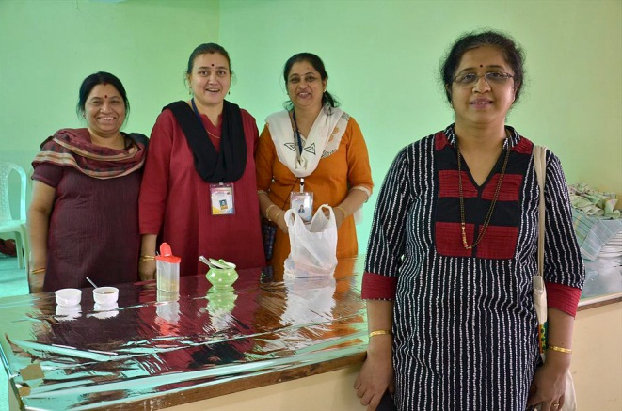
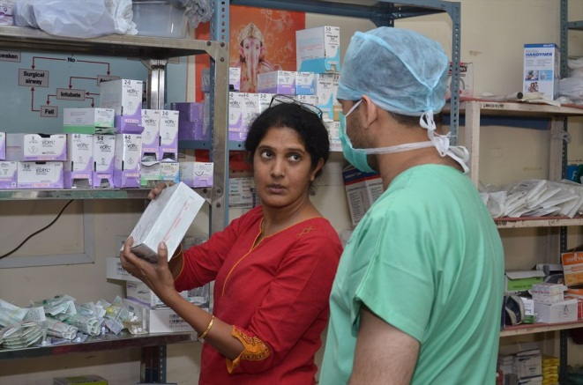
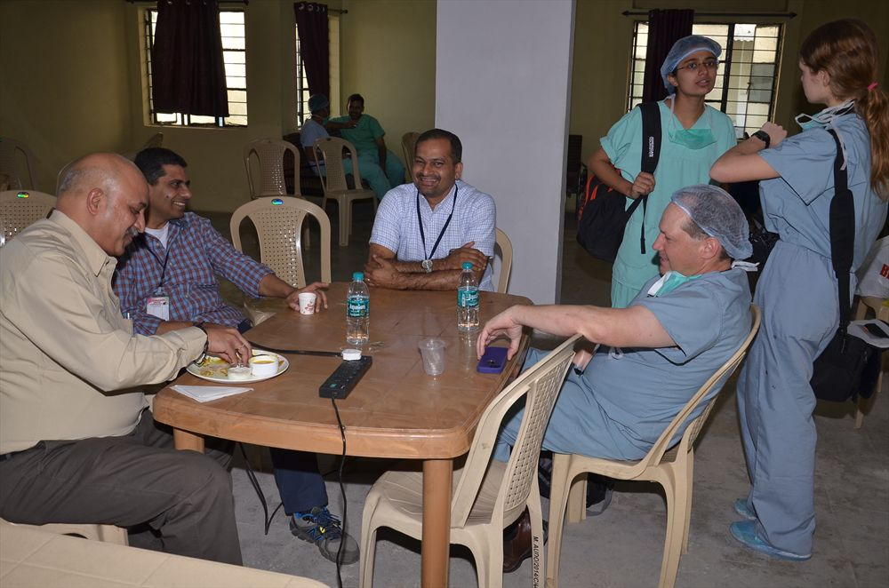
A typical day during Surgical mission

Slide 16
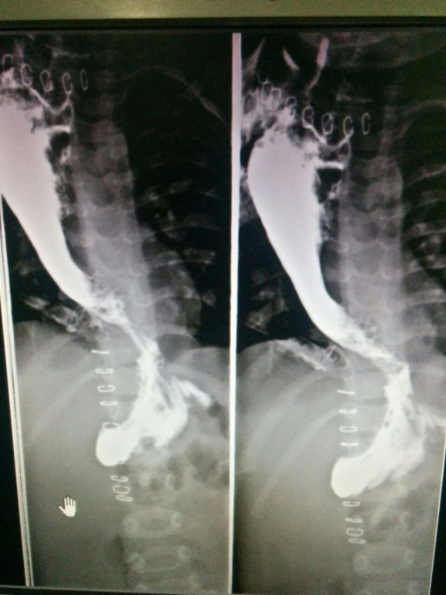
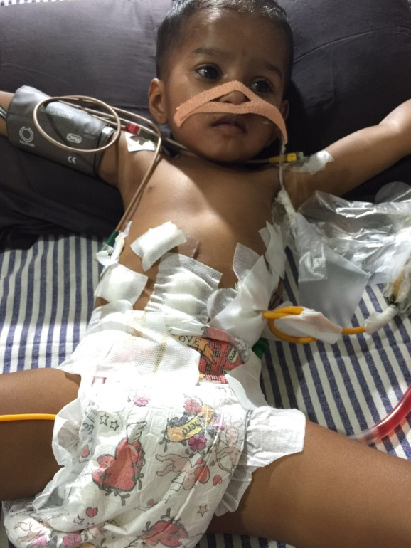
Impact of surgical intervention
Child with Oesophageal Corrosive stricture – combined laparoscopic & thoracoscopic procedure lasting 12 hours done successfully on a 2-year old child.
Video on the right shows child with mother post-operative being able to drink water with ease!

Slide 17
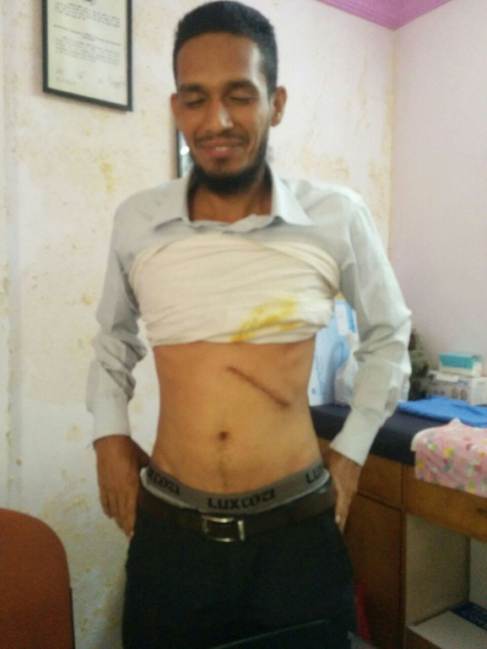
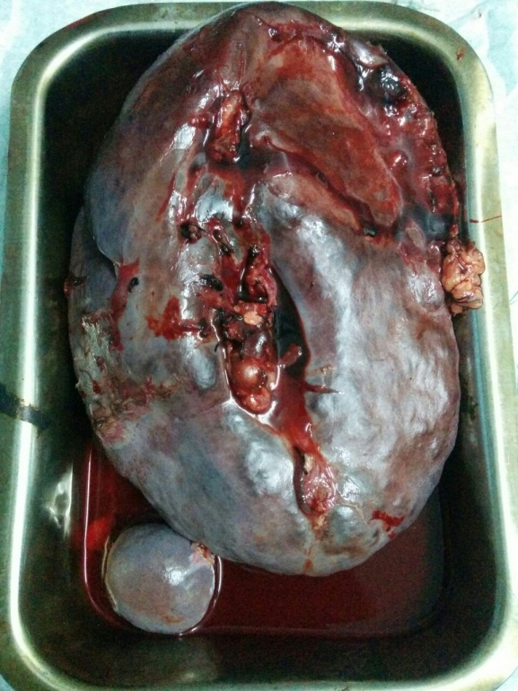
Impact of surgical intervention
A case of extra hepatic portal hypertension. Patient reported fall in platelets & vomiting of blood for the past 7 years before coming for operation. Splenectomy + lienorenal shunt procedure done successfully. Photo on right shows removed spleen weighing 2.5 kgs! Patient is now happy to be back to school with a normal life and regaining confidence after missing so much of school life!

Slide 18
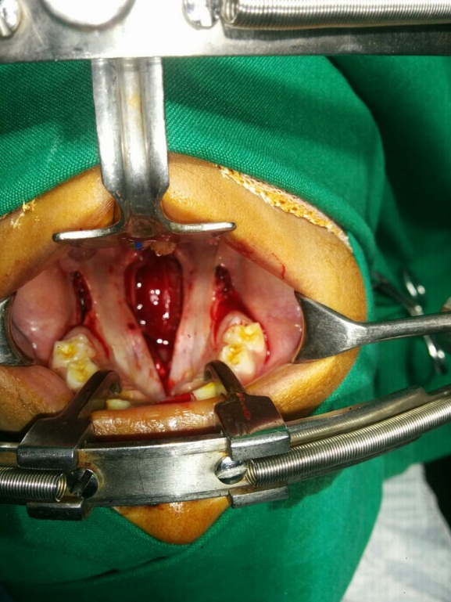
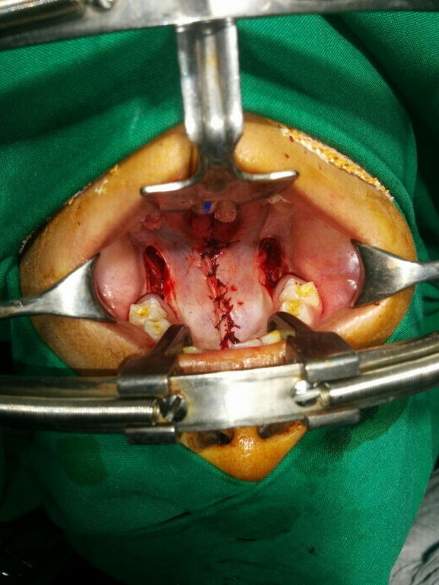
Impact of surgical intervention
Cleft Palate before and after repair. This was a redo case (meaning patient was operated earlier elsewhere without success). Could eat & speak well with enhanced clarity. Resumed a confident school life with much increased peer-group activity participation.

Slide 19
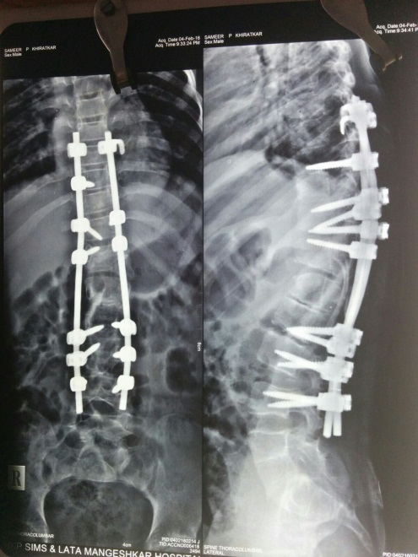
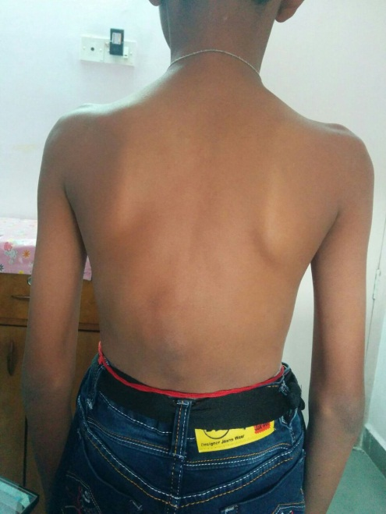
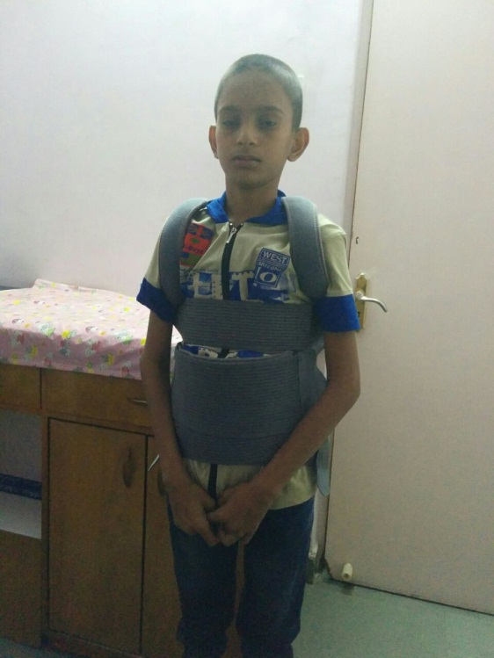
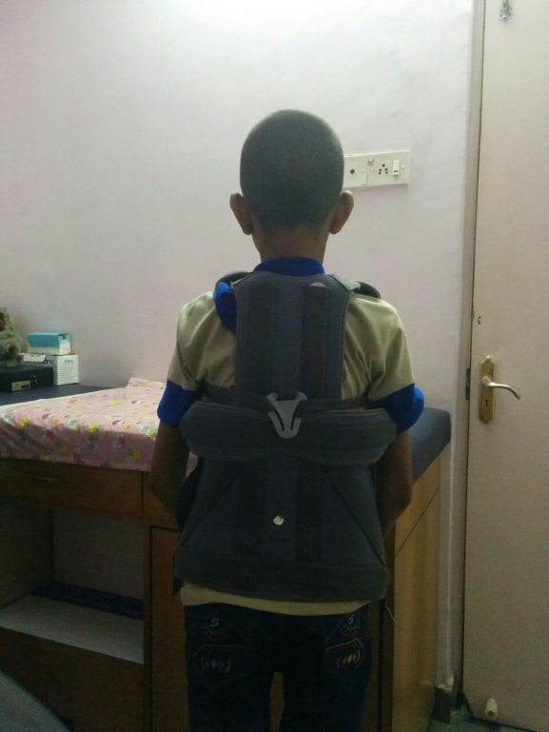
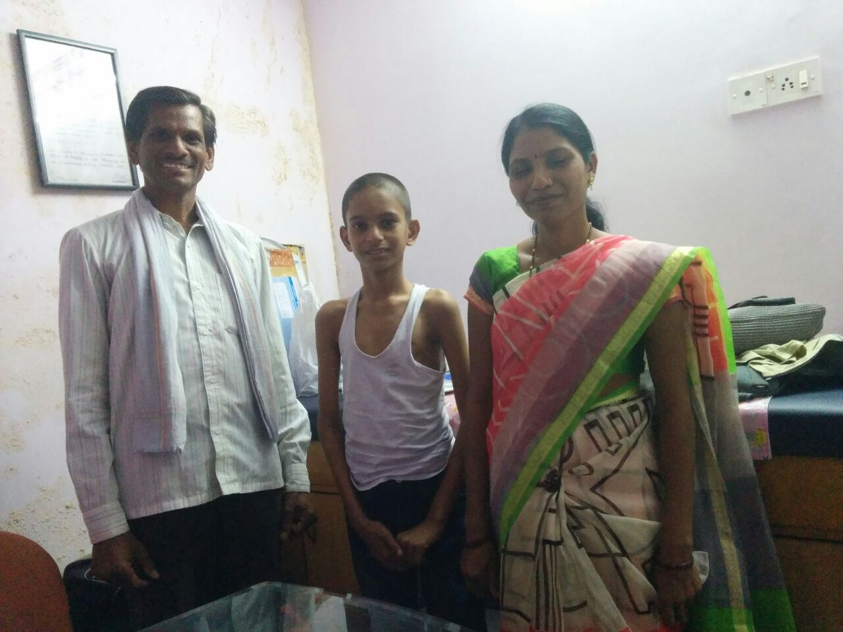
Impact of surgical intervention
Case: Male child requiring major spine surgery. MRI scans & post-op photos show child wearing braces and walking upright, standing proud and happy with equally happy parents!

Slide 20
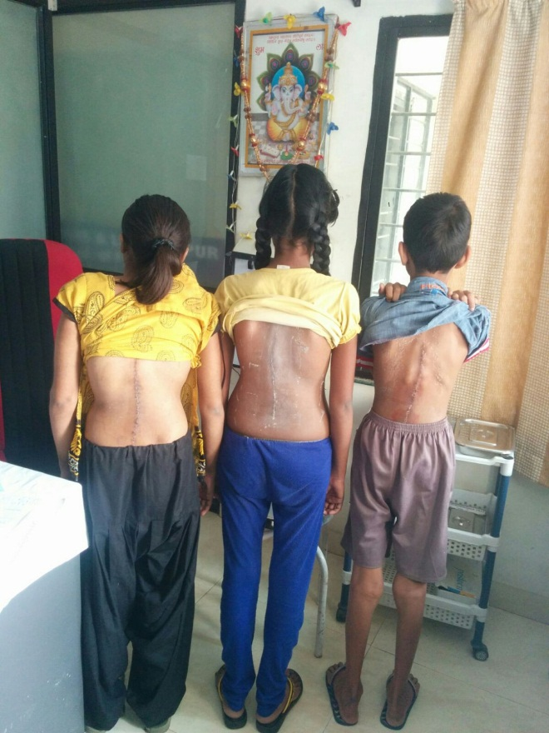
Impact of surgical intervention
BSM-2016 saw many major spine surgeries being done for free! These surgeries would have cost over many lakhs each. All cases showing satisfactory and positive post-operative recovery.

Slide 21
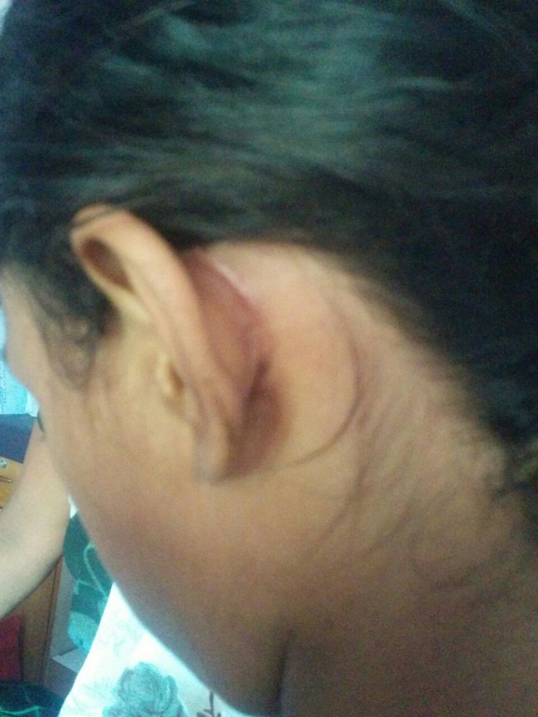
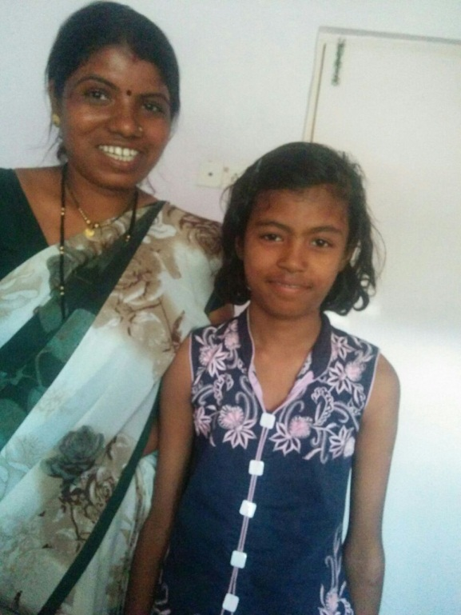
Impact of surgical intervention
Case: Girl child with ear disharge & poor hearing.
The smile on the mother’s face post-surgery is self explanatory! No more ear-discharge and enhanced hearing to normal levels.

Slide 22
Humane Approach
In-ward anxiety reduction program
Games, Art/craft, portrait artist, etc.
Food & Beverages for all
Milk, breakfast, lunch, dinner + Tea/coffee
Proper counselling and post-op advice
Thorough post-op reviews and follow-up done

Slide 23
The road ahead…
Consolidate our work – with your cooperation!
Refinement of healthcare service delivery
Increase scope of engagement
Nursing education, Surgical CME programs, etc..

Slide 24
Thank you !
www.bmfindia.org

